Slide 1
Reflections on Data Science, Machine Learning, AI
Raymond Ng
Director, Data Science Institute, UBC
Canada Research Chair on Data Science and Analytics
Professor, Computer Science, UBC

Slide 2
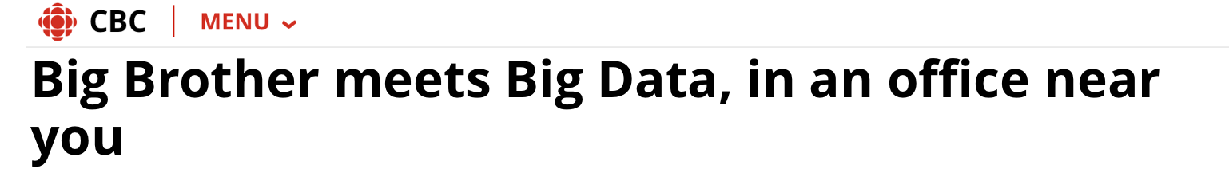
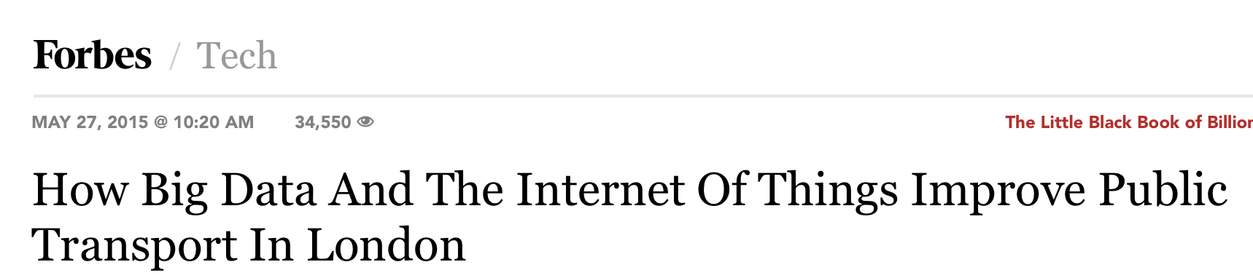

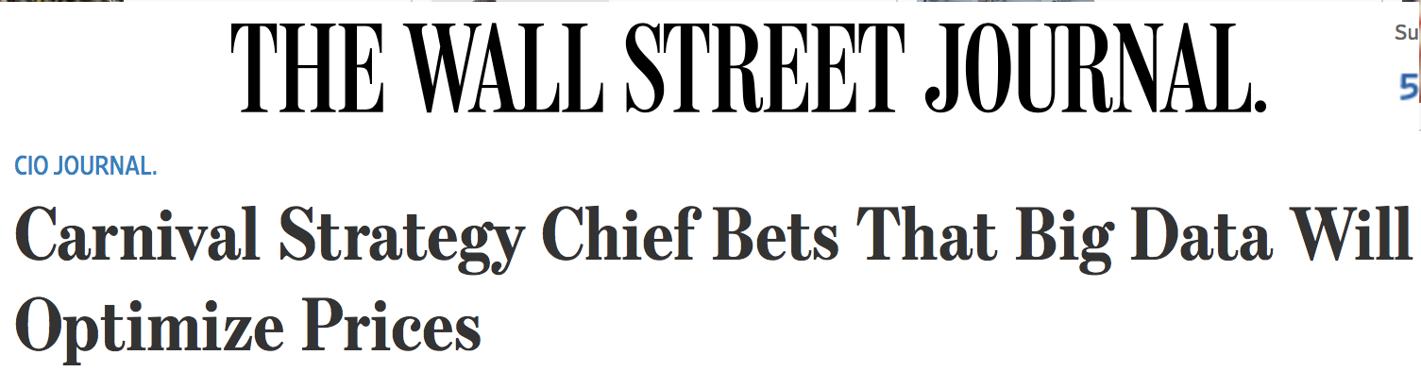

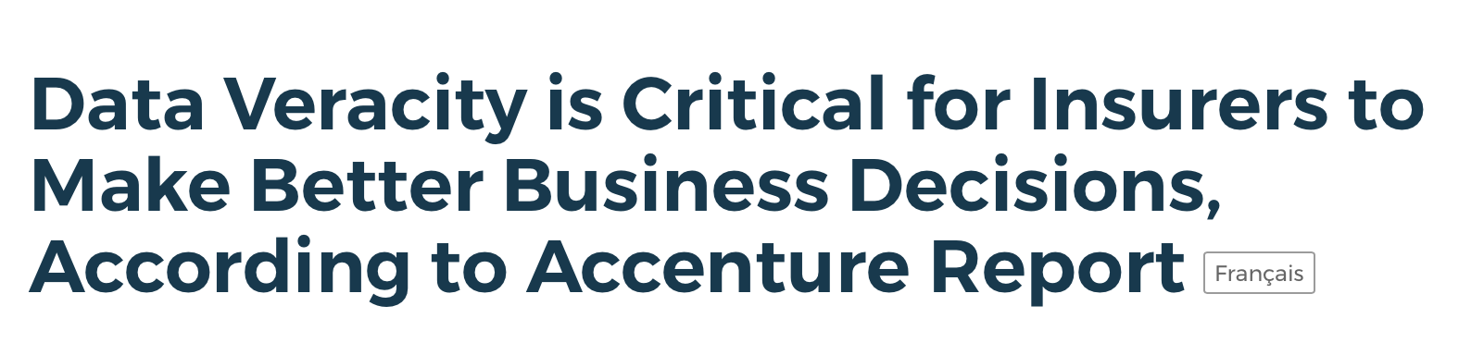
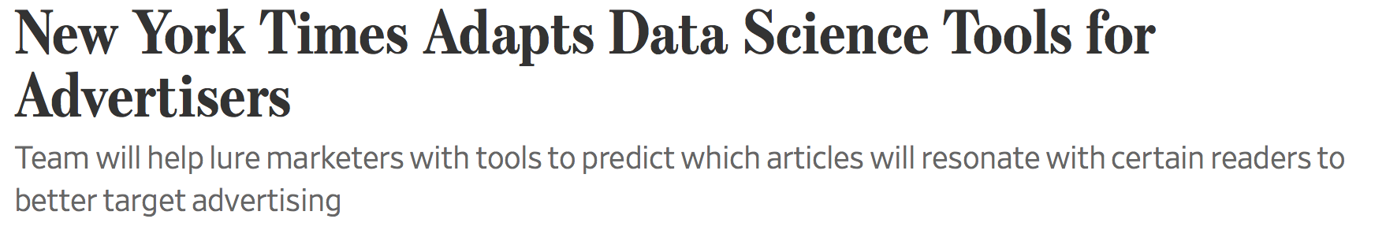
Data Science in the News…

Slide 3
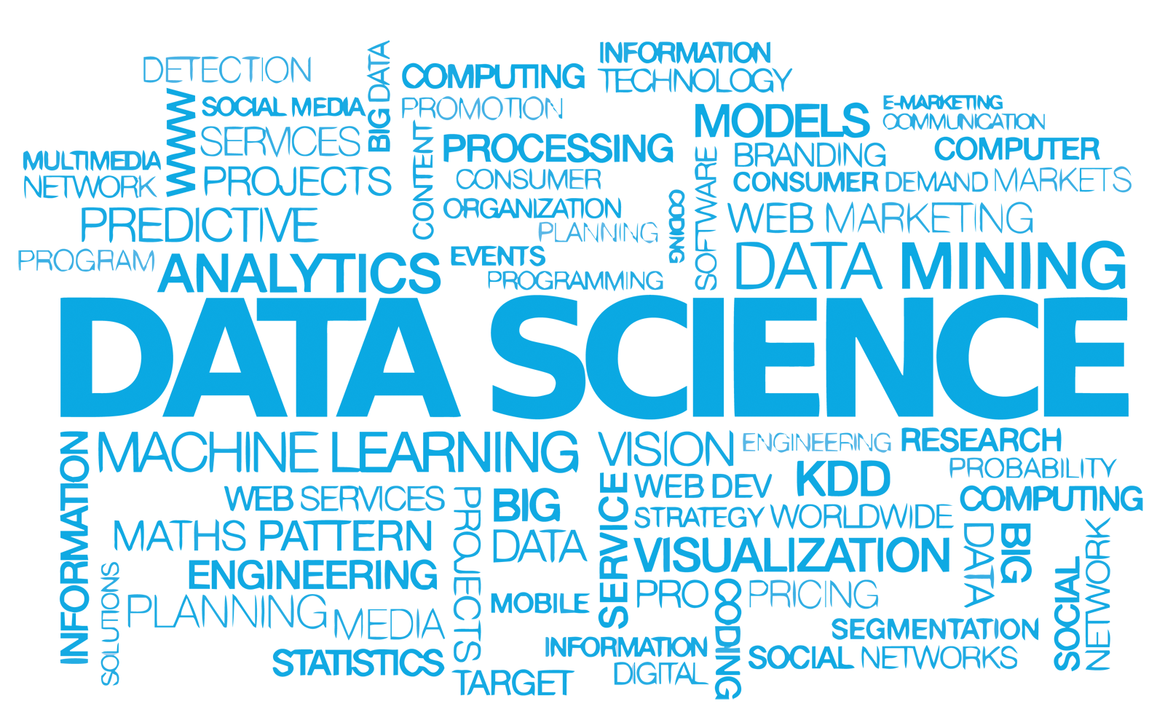
Data Science Word Cloud

Slide 4
What is Data Science?
Refers to methods, processes and tools that allow a user to extract useful information from complex data collections
An interdisciplinary field:
Data mining, machine learning, statistical inference, predictive modeling, databases, visualization, high performance computing, data privacy, security, etc.
Is critical for organizations and companies to make decisions and drive innovation
Notes:
Is it the same as bioinformatics?

Slide 5
Data Science = Big Data??
Not the “same thing”
If Big data = crude oil
Big data is about extracting “crude oil”, transporting it in “mega tankers”, siphoning it through “pipelines”, and storing it in “massive silos”
Data science is about refining the “crude oil”, i.e., building on top of Big Data
Carlos Samohano
Founder, Data Science London

Slide 6
Data Science as a Unifier
Data Science
Humanities
Machine/ Statistical Learning
Application Domain Expertise
Visualization
Mathematical Optimization
Social Science
Law
Data Management

Slide 7
Holistic Approach to Data Science
Core
Data Security & Privacy
Data
Acquisition
Making Data Trustable & Usable
Management of Big Data
Modeling & Analysis
Dissemination & Visualization
Data
Preservation
Ethics, Policy & Social Impact
Application
Application
Application
Application

Slide 8
Core Issues
Data cleaning
Sampling
Data provenance
Linking data
Data access
Real-time interaction
Making Data Trustable & Usable
Modelling & Analysis
Big Data Management
Data Visualization & Dissemination
Data mining and Machine Learning
Supervised and Unsupervised methods
Visualization for wider audience
Visualization for data exploration
Open data technologies

Slide 9
Data Science vs Machine Learning vs AI
Data Science
Artificial Intelligence
ML/DM/
Analytics
“Data science systems produce insights;
Machine learning systems generate predictions;
AI systems make decisions and take actions”

Slide 10
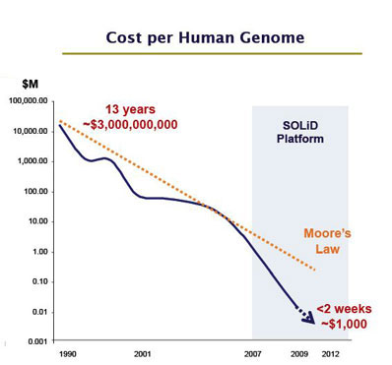
Data Science Meets Health Science: Info Tech Meets Bio Tech
Advances in:
CPU/storage capacity
data capture
searching and database mgmt
Cloud, Hadoop
algorithms
statistics
mathematics, etc.
Very Exciting Times!
Notes:
To talk about how DS meets PM, I think it is important to talk about how rapid advances of bio-tech meet rapid advances in info tech and sciences
This diagram, familiar to some of you, talks about sequencing a complete human genome. The cost drops significantly in 25 yrs. The dip here corresponds to high-thruput sequencing.
While this diagram is for sequencing, a similar trend in cost-effectiveness and throughput applies to many molecular technologies.
Within the same time period, on the info tech side, we have seen rapid advances in …

Slide 11
How the 4V’s Challenge Health Care and Health Research?
#1 Volume:
Rapid advances in biotech, e.g., sequencing of all flavours, mass spectrometry, point-of-care diagnostics
Electronic Health Records: governments (e.g., MoH) making longitudinal data (e.g., months, years) on whole population available
Data sharing across jurisdictions, collaborators also increase the dataset size
Many new ways of collecting data, e.g., health apps
Notes:
genomeAsia 100K, microbiome 16S sequencing

Slide 12
#2 Variety
Laboratory Results
Medications
Clinical
Imaging
Omics
Biobanks
Genotype
Omics
Omics
Environment
Demographics
Hospitalization
Potential of modelling across these modalities is HUGE
Notes:
microbiome

Slide 13
#3 Velocity
The speed that data are collected or generated, e.g., health monitoring apps
E.g., Text data, e.g., whatsapp, clinical trials
Patients describing their own sentiments – a “window” into their psychological states, their cognitive states, etc.
Longitudinal text – capturing changes over time -can be the basis of a powerful predictive model
Building a joint model using multi-omics and text to monitor chronic disease management (e.g., even covid recovery) is not far away
Notes:
genomeAsia 100K, microbiome 16S sequencing

Slide 14
#4 Veracity
The truthfulness/reliability/quality of data and data sources, e.g.,
public repositories vs MoH data
Missing values or errors in EHR
Self-declared survey data, sentiment data
Accuracies of devices
Notes:
genomeAsia 100K, microbiome 16S sequencing

Slide 15
Neural Network Learning for Biomedical Research

Slide 16
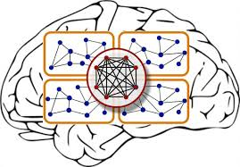
Neural Networks: Simulating Human Brains?
To build a predictive model, why not do what a human brain can do?
In particular, neuroscience reveals the existence of massively connected networks of neurons
In 1943, McCulloch and Pitts proposed a simple mathematical model for neurons, now known as neural networks
(journal.frontiersin.org)
16

Slide 17
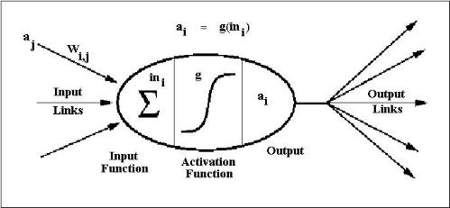
Basic Structure of a Network Unit
A Neural network composed on nodes/units connected by links
A link from unit i to unit j propagates an activation a_{i} to possibly trigger an activation a_{j}
(en.wikibooks.org)
17

Slide 18
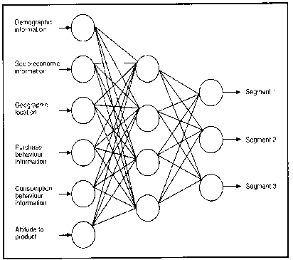
Feed-forward and Recurrent Networks
This network determines to which segment a customer belongs
This is an example of a feed-forward network
No loops, forming an acyclic graph
A recurrent network has loops and may take time to reach a steady state
18

Slide 19
Hidden Layers and Deep Networks
Our example has a hidden layer of units
allow us to model quantities not directly measured
features are being “learned”
Common to have units arranged in layers, i.e., inputs from the preceding layer and outputs to the next layer
”Deep" in "deep learning" refers to the number of layers through which the data are transformed
called the credit assignment path (CAP) depth
for a feed-forward network, the depth is 1 + the number of hidden layers
”deep” means CAP > 2
extra layers are intended to ”extract/engineer” better features
19

Slide 20
Some Deep Learning Applications
Image recognition: computational radiology
E.g., Imperial College to provide image-based assessments of traumatic brain injuries
Drug design and toxicology
E.g., AtomNet for virtual drug screening and target discovery
Modeling of EHR data
E.g., Children's Hospital Los Angeles to improve pediatric intensive care diagnosis
Bioinformatics
E.g., regulatory genomics (Montgomery et al., Nature 2010)
20

Slide 21
But Buyers Beware…
Neural networks have many parameters to “estimate”
Deeper networks have even more parameters to fit
Paramount to have a lot of high quality (training) data
Much easier to overfit than many other methods
The structure of a network is not known a priori
Yet results typically sensitive to the structure
Interpretation is hard
A key strength of a deep network is feature engineering
But the features may not have natural ”real world” meanings
21

Slide 22
Summary: Machine Learning, AI Opportunities and Boundaries
Data Science
Artificial Intelligence
ML/DM/
Analytics
Take home: Remember that high quality data
is the pre-requisite of ML and AI methods

Slide 23
Thank You! rng@cs.ubc.ca

Slide 24
Summary
The new “crude oil”, Big Data present great opportunities
Data Science “refines crude oil” to bring great value:
More jobs: lots of work to do to exploit these data assets
New insights leading to smarter decisions/policies
When applied to health, better care and more advanced research
This program covers all these aspects and more

